Slide 1

Modern Style
COMPARATIVE ANALYSIS OF DEPRECIATION METHODS
Excel-driven model, 10-year schedules, advanced calculations & insights
Borcelle

Slide 2

Introduction
Depreciation is the systematic allocation of the cost of a tangible asset over its useful life. It reflects the reduction in value of an asset as it is used over time.
The scope of this comparative analysis includes understanding the key differences between the Straight-Line and Diminishing Balance methods of depreciation. This analysis will help determine which method is more suitable under different circumstances, considering factors like asset cost, additional costs, asset lifespan, and salvage value.

Slide 3

Input Assumptions
450,000
Asset Cost
Additional Cost
50,000
500,000
Asset Price
Scrap Value
50,000
Useful Life
10 years

Slide 4

Methodology
Straight-Line: Annual Depreciation = (Asset Price − Scrap Value) ÷
Useful Life.
Straight-Line result: (500,000 − 50,000) ÷ 10 = 45,000.00 per year.
Straight-Line rate = Annual Depreciation ÷ Asset Price = 9.00%.
Diminishing Balance: Depreciation = Beginning Book Value × DB Rate.
DB Rate = 1 − (Scrap Value ÷ Asset Price)^(1 ÷ Useful Life) = 20.5672%.

Slide 5


Key Findings
SL annual depreciation = 45,000.00
DB rate = 20.5672%.
DB Year 2 depreciation = 81,685.45.
DB ending Year 4 book value = 199,053.59.
Total depreciation under both methods = 450,000.00.
Therefore, the methods differ primarily in the timing of expense recognition, not the total depreciable amount when the same residual value is achieved.

Slide 6
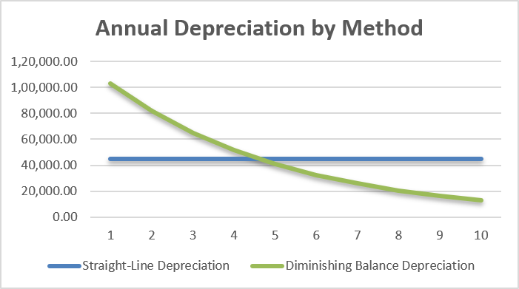
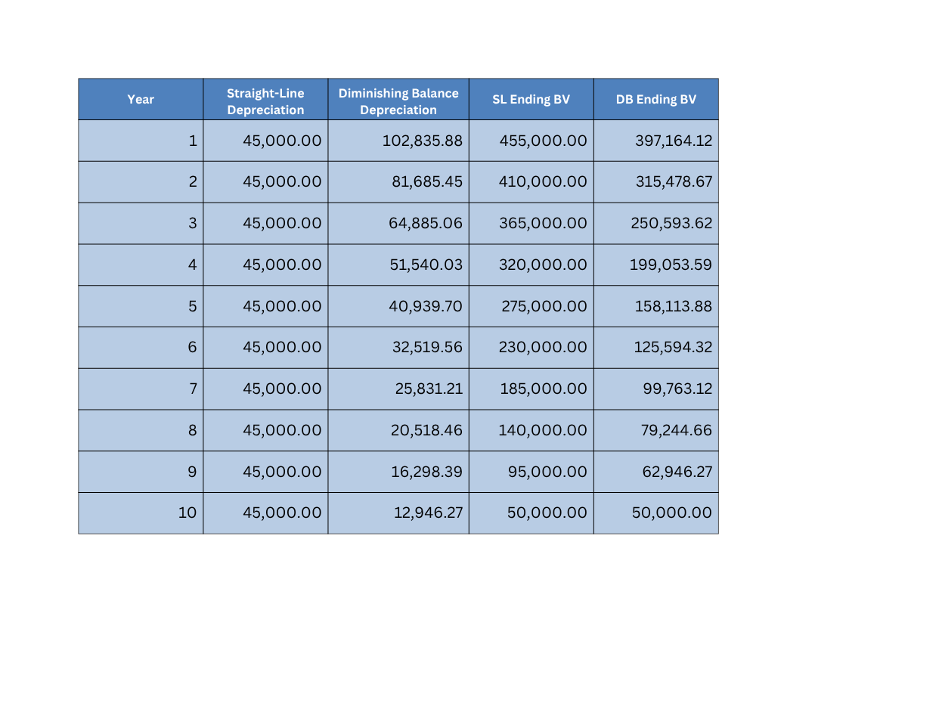
10-Year Depreciation Schedule

Slide 7

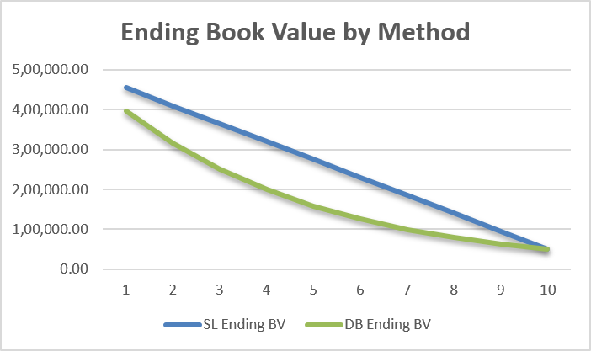
Comparative Analysis of Both Methods
Borcelle
The Straight-Line method provides a consistent annual depreciation expense, which is simple to calculate and understand. It is suitable for assets that provide consistent utility over time.
The Diminishing Balance method provides higher depreciation expense in the earlier years and lower expense in the later years. It is suitable for assets that lose value quickly or become obsolete faster.
Finance Presentation

Slide 8

Conclusion
Use Straight-Line when the asset provides relatively consistent utility over time and a simple, uniform expense pattern is appropriate.
Use Diminishing Balance when the asset is expected to lose value faster in its early years or become obsolete quickly.
For real-world accounting/tax decisions, apply the relevant accounting standards and jurisdiction-specific rules in addition to the project model.

Slide 9
Modern Style
THANK
YOU
Borcelle

